Slide 1
Unit 4: Application Development in the Cloud
Cloud-Native Development
Containers
Kubernetes
Practical Deployment

Slide 2
What is Cloud Application Development?
Building applications for cloud platforms
Uses cloud infrastructure and services
Focus on scalability and reliability
Notes:
Reliability in cloud computing refers to the ability of cloud services to consistently perform as expected, ensuring users can access their data and applications without interruptions or failures.

Slide 3
Need for Cloud-Based Applications
Growing user demand
Elastic resource usage
Cost efficiency
High availability

Slide 4
Traditional Application Architecture
Monolithic structure
Single deployment unit
Difficult to scale
Tightly coupled components
Notes:
Tightly coupled components are highly interdependent parts of a system where changes in one component can significantly affect others, leading to reduced flexibility and increased complexity.

Slide 5
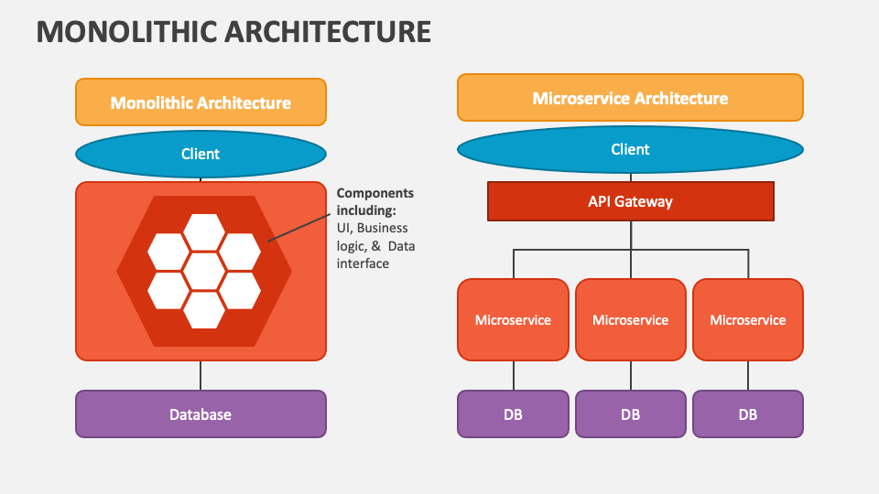
Monolithic Vs Microservice

Slide 6
Limitations of Traditional Applications
Slow updates
High downtime
Limited scalability
Complex maintenance

Slide 7
Cloud-Native Application Architecture
Microservices-based
Independent services
Automated deployment
Resilient design

Slide 8
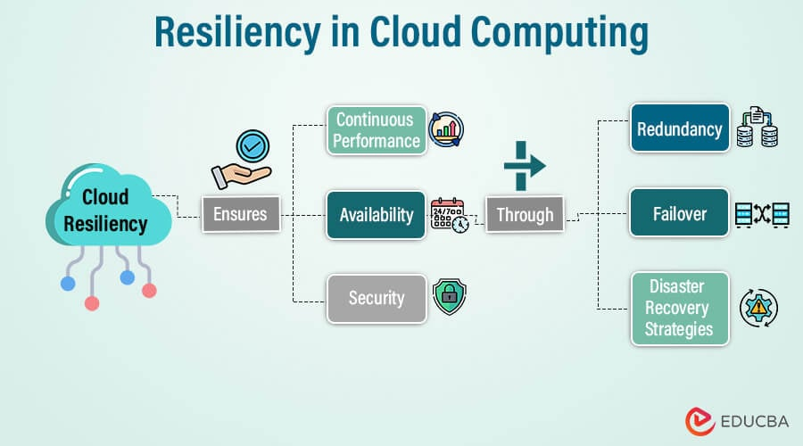
Resiliency in Cloud Computing
Notes:
Cloud redundancy is duplicating critical IT assets (data, servers, networks) across multiple locations or instances to ensure continuous availability and rapid recovery from failures, using techniques like data replication, failover systems, and multi-region deployments to prevent downtime from hardware issues, disasters, or cyberattacks. It's the core of building resilient, highly available cloud architectures.

Slide 9
Cloud-Native Development Explained
Applications designed specifically for cloud
Uses automation and orchestration
Optimized for distributed systems
Notes:
cloud-native development heavily relies on automation and orchestration to build, deploy, and manage scalable, resilient applications using microservices, containers (like Docker), and orchestrators (like Kubernetes) for tasks like scaling, healing, and updates, enabling speed, efficiency, and agility in modern cloud environments

Slide 10
Key Principles of Cloud-Native Development
Loose coupling
Scalability
Resilience
Automation

Slide 11
Microservices Architecture
Application divided into small services
Each service handles one function
Independent deployment

Slide 12
Microservices Example
User Service
Order Service
Payment Service
Inventory Service

Slide 13
Advantages of Microservices
Independent scaling
Faster development cycles
Fault isolation
Notes:
Fault isolation in cloud computing is designing systems to contain failures within specific boundaries, preventing a single component's failure (like a microservice or container) from causing a cascading system collapse, achieved through techniques like microservices, containerization, event queues, resource partitioning, and redundancy, ensuring resilience and high availability for the overall application.

Slide 14
Challenges of Microservices
Increased complexity
Service communication
Monitoring overhead

Slide 15
Communication Between Services
REST APIs
gRPC
Message queues

Slide 16
Scalability in Cloud Applications
Ability to handle variable loads
Horizontal scaling preferred
Automatic scaling supported

Slide 17
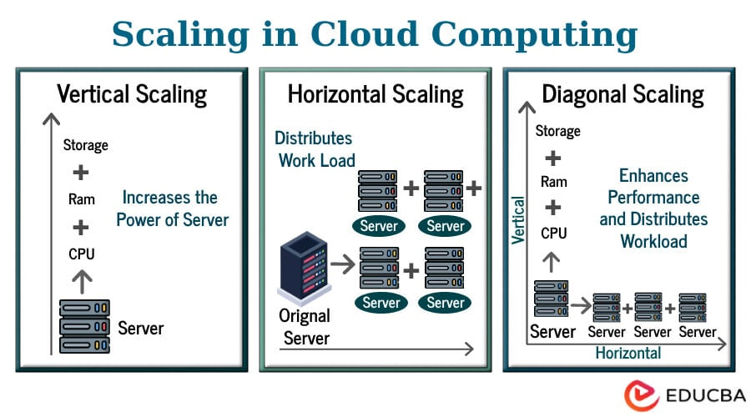
Scaling

Slide 18
Resilience and Fault Tolerance
Automatic recovery from failures
Service redundancy
Minimal downtime

Slide 19
Introduction to Containers
Lightweight execution environments
Package application with dependencies

Slide 20
Why Containers Are Needed
Environment consistency
Portability
Faster deployments

Slide 21
Container Components
Application code
Runtime
Libraries
System tools

Slide 22
Containers vs Virtual Machines
Containers share OS kernel
Virtual machines use full OS
Containers are lightweight

Slide 23
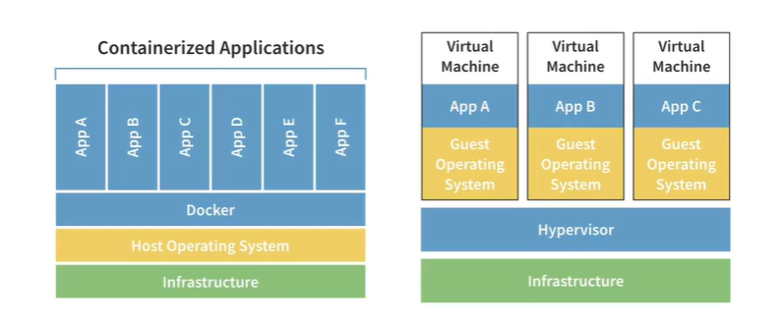
Containers vs VM

Slide 24
Docker Platform Overview
Popular container platform
Uses images and containers
Supports DevOps workflows
Notes:
Use of Images and Containers: Applications and their dependencies are packaged into immutable "images," which are then run as "containers," ensuring consistency across different environments.

Slide 25
Docker Image Lifecycle
Create Dockerfile
Build image
Push to registry
Run container

Slide 26
Benefits of Containers
Fast startup
Resource efficiency
Easy scaling

Slide 27
Introduction to Kubernetes
Container orchestration system
Manages large-scale container deployments

Slide 28
Why Kubernetes is Required
Manages multiple containers
Handles failures automatically
Provides load balancing

Slide 29
Kubernetes Features
Auto-scaling
Self-healing
Service discovery

Slide 30
Kubernetes Architecture Overview
Control plane
Worker nodes
Pods

Slide 31
Control Plane Components
API Server
Scheduler
Controller Manager

Slide 32
Worker Node Components
Kubelet
Container runtime
Pods

Slide 33
Pod Explained
Smallest deployable unit
One or more containers
Shared networking

Slide 34
Deployment Explained
Manages replicas
Ensures desired state
Supports rolling updates

Slide 35
Kubernetes Service Explained
Stable network endpoint
Connects users to pods

Slide 36
Types of Kubernetes Services
ClusterIP
NodePort
LoadBalancer

Slide 37
Unit 4 Practical Work
Practical 1: Cloud-native application
Practical 2: Kubernetes deployment

Slide 38
Practical 2: Kubernetes Deployment
Local cluster setup
Deploy multi-container application

Slide 39
Tools Used in Practical 2
Docker
Minikube or K3s
kubectl

Slide 40
Application Architecture for Practical 2
Front-end service
Back-end service
REST communication

Slide 41
Deployment Workflow
Create images
Write YAML
Apply configuration
Verify deployment

Slide 42
Scaling in Kubernetes
Increase replicas
Handle higher traffic

Slide 43
Self-Healing in Kubernetes
Automatic pod restart
High availability

Slide 44
Real-World Use Cases
E-commerce
Banking systems
Cloud-native platforms

Slide 45
Advantages of Kubernetes
Automation
Reliability
Scalability

Slide 46
Challenges in Kubernetes
Learning curve
Operational complexity

Slide 47
Exam-Oriented Key Points
Cloud-native
Containers
Kubernetes
Pod
Service

Slide 48
Summary of Unit 4
Cloud-native apps are scalable
Containers ensure portability
Kubernetes automates deployment

Slide 49
Conclusion
Unit 4 builds strong cloud foundation
Essential for modern software engineers

